Slide 1

Words of our Culture
Pete Rai

Slide 2


May the force be with you
I’ll make him an offer he can’t refuse
Here’s looking at you kid
Get your hands off me you damn dirty ape
Mama always said, life is like a box of chocolates
Come with me if you want to live

Slide 3
A linguistic analysis of the utterances within all the great English language movies, from the birth of sound cinema to the present day
Presented in a visual model
words which characterize a given movie
movies which align with a given word

Slide 4
demo
Notes:
JFK -> president -> Amistad -> slave -> Spartacus -> rome
Index -> computer -> robot

Slide 5
How’s it work under-the-hood?
Choose the movies
Gather utterances into a corpus
Normalise the text within the corpus
Stem the individual words
Store the corpus in a data model
Analyse for statistical significance

Slide 6
1 of 6: Choose the movies
Popular and well known: Highest grossing, Oscar winning
Made after the invention of sound on film
Contain speech which is mostly in the English language
Balanced within the years being considered: 1930 - 2017
I've seen them and I like them 😃
Full index

Slide 7
pos | movie | words / min
1 | The Internship | 169.7815
2 | Death of a Salesman | 165.9130
3 | Stage Door | 164.4891
4 | His Girl Friday | 162.7065
5 | Horrible Bosses | 156.8878
pos | movie | words / min
5 | Fantasia | 14.3040
4 | Eraserhead | 8.2235
3 | City Lights | 6.5287
2 | Modern Times | 3.4368
1 | One Million Years B.C. | 1.7100

Slide 8


2 of 6: Gather utterances into a corpus
Via openly available subtitling tracks
In a standard(ish) SRT format
A very large amount of data wrangling was required
Community based, so quality was variable
Riddled with OCR errors
Contained some non-spoken ques
Metadata from IMDB

Slide 9
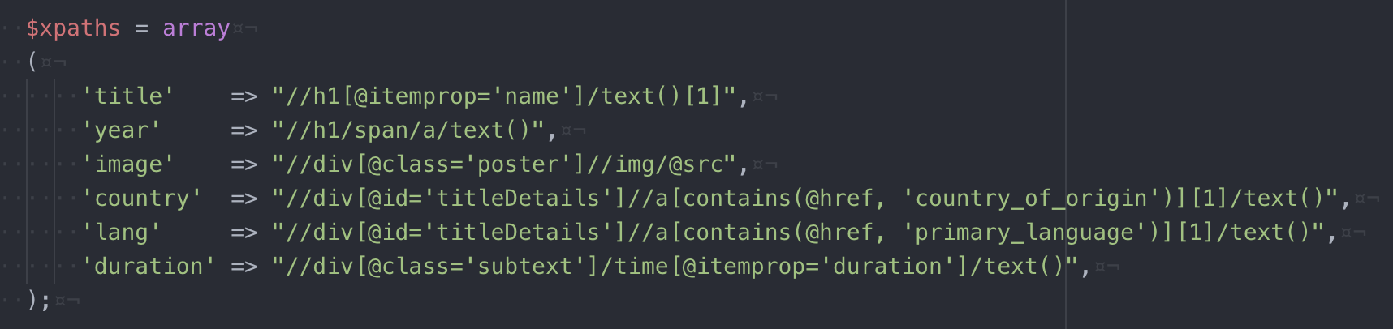
Use XPATH to “read” webpages
//div[@id='titleDetails']//a[contains(@href, 'country_of_origin')][1]/text()
Let’s try it

Slide 10
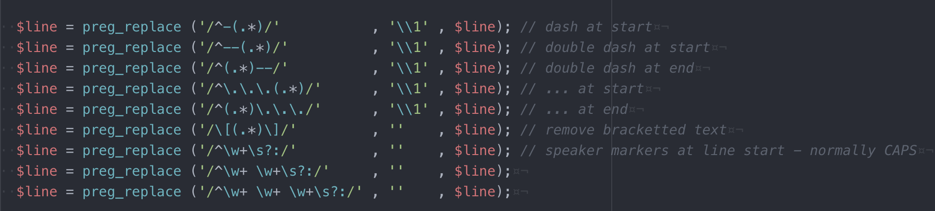
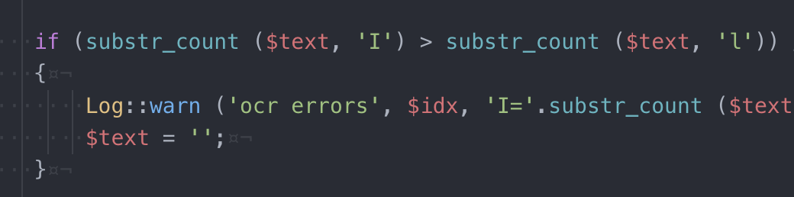
You gotta love regex
OCR error spotter

Slide 11
Status Post Step 2
They grab Ugarte, then she walks in. That's the way it goes. One in, one out. Sam. Yes, boss? If it's December 1941 in Casablanca, what time is it in New York? What? My watch stopped. I bet they're asleep in New York. I bet they're asleep all over America. Of all the gin joints in all the towns in all the world she walks into mine. What's that you're playing? A little something of my own. Well, stop it. You know what I want to hear. No, I don't. You played it for her. You can play it for me. I don't think I can remember. If she can stand it, I can. Play it. Yes, boss.

Slide 12
3 of 6: Normalise the text within the corpus
Conversion of accented characters to their English language variant. E.g. the accented letter é was normalised to e and the letter ä was normalised to a, etc.
All whitespace was normalised to a single space. This step also removed all non-space whitespace like tabs, new-lines, etc.
All punctuation was removed. E.g. the word it’s became its and the word you're was normalised to youre, etc. This also removed full stops, so now we also lost sentence breaks.
All text was converted to lowercase.

Slide 13
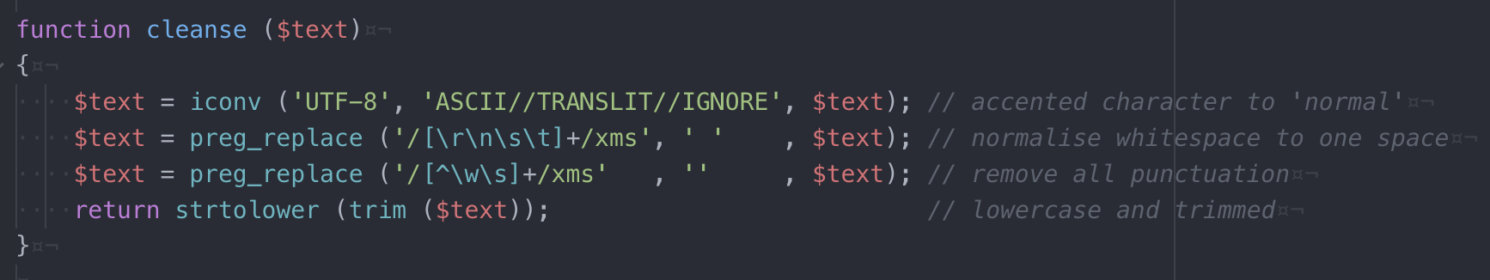
A standard cleanse function

Slide 14
Status Post Step 3
they grab ugarte then she walks in thats the way it goes one in one out sam yes boss if its december 1941 in casablanca what time is it in new york what my watch stopped i bet theyre asleep in new york i bet theyre asleep all over america of all the gin joints in all the towns in all the world she walks into mine whats that youre playing a little something of my own well stop it you know what i want to hear no i dont you played it for her you can play it for me i dont think i can remember if she can stand it i can play it yes boss

Slide 15
4 of 6: Stem the individual words
A stemmer is defined as:
“an algorithm for removing inflectional and derivational endings, in order to reduce word forms to a common stem”
For: happy, happily, happier, happiest, happiness, etc
Root word = happy
Stem word = happi
No reason for the stem to be a valid word in itself
Only that all the right words consistently reduce to the same stem
The Porter Stemmer was created by the English linguist Mark Porter

Slide 16
Status Post Step 4
thei grab ugart then she walk in that the wai it goe on in on out sam ye boss if it decemb 1941 in casablanca what time is it in new york what my watch stop i bet theyr asleep in new york i bet theyr asleep all over america of all the gin joint in all the town in all the world she walk into mine what that your plai a littl someth of my own well stop it you know what i want to hear no i dont you plai it for her you can plai it for me i dont think i can rememb if she can stand it i can plai it ye boss

Slide 17
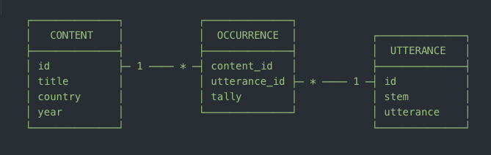
5 of 6: Store the corpus in a data model
Stored in a simple MySQL schema
1,700 content items
124,428 utterances (individual words - unigrams only)
260,3821 occurrences
14,856,258 words spoken

Slide 18
6 of 6: Analyse for statistical significance
How to identify statistically significant words as opposed to just frequently used words?
Casablanca:
Most frequent words: you, i, the, to, a, it, in, of, …
Statistically significant words: rick, visa, letters, lisbon, ilsa, …
The word rick:
Only said in 2.3% of movies – mean 0.2 utterances/movie
But is it said 74 times in Casablanca!

Slide 19
Using a log-likelihood algorithm
Log-likelihood is a statistical technique that helps us identify significant words in a given corpus when compared with a wider corpus.
Essentially, it helps us compare how likely a word would be to occur in any movie and then contrast that with how often it actually occurs in a specific movie.
This log-likelihood value is akin to looking for the probability of occurrence for a given word.

Slide 20
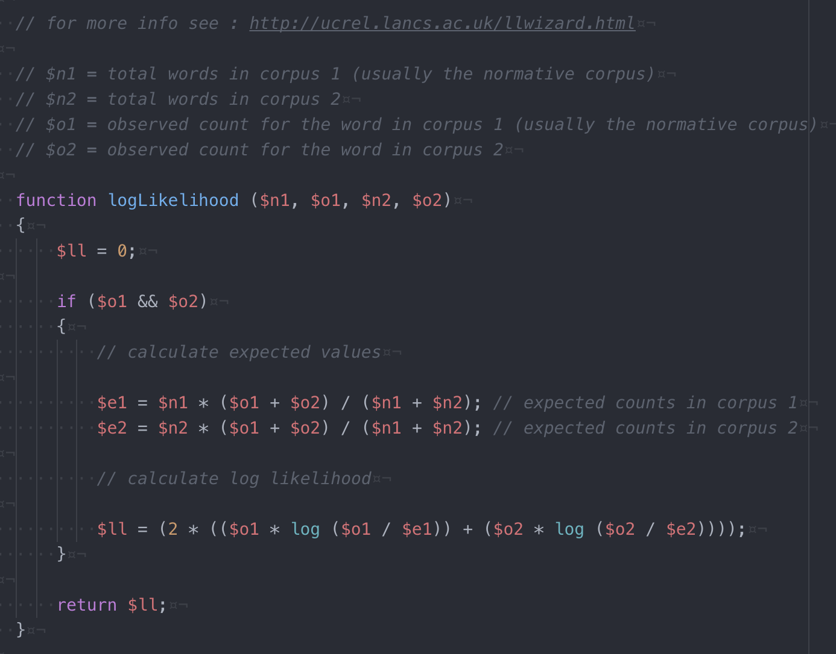
See it in action

Slide 21
Bubbles visualisation
https://github.com/pete-rai/p5js-bubbles
JQuery slide-in
https://github.com/pete-rai/jquery-slidein

Slide 22
Other observations…
Unigrams vs Bigrams
Temporal analysis:
The F word
The N word
Gay vs Gay
Semantic analysis:
Genre spotting: wagon, posse, sheriff, saloon, …
Franchise spotting: warp, vulcan, beam, shields, …
Impersonal pronouns: you, i, we, …

Slide 23
It’s all in the pubic domain
https://github.com/pete-rai/words-of-our-culture

Slide 24

coming soon
10 Million Words

Slide 25
Words of our Culture
Pete Rai

